Slide 2
INFORMATIONAL MEETING
REQUEST FOR PROPOSALS NO. 26-07
Learning Management Systems
June 18, 2026

Slide 3
INTRODUCTIONS
Deb Norkevicus
  Professional Services Contract Specialist
  Provide an eBusiness Overview
  Provide a general overview of the RFP requirements
Renelda Colvin
  DBE/DB Contract Compliance Specialist
  Will address the DBE / DB requirements
Danielle Jacobson / Steve Sarosi
  Assist Director of Employment & Development / Senior Learning & Dev. Specialist (Project Manager for this RFP)
  Will provide an overview of scope of services

Slide 4
VIRTUAL
AND PHONE
ETIQUETTE
Please make sure your virtual microphones and phone are on mute throughout the duration of the meeting.
If you are joining through Teams Virtual platform, all questions should be entered in the Chat Box.
If you are joining by phone, you need to announce yourself and the company you represent before asking your question.
ALL questions must also be submitted in writing to:
Dnorkevicus@rideprt.org

Slide 5
eBusiness Overview

Slide 6

eBusiness Registration
You must be registered:
  To receive notifications for this RFP
  To submit a proposal for this RFP
Registration estimated time is 5-10 minutes to complete
Recommend registering when there is time to complete

Slide 7
Already Registered?
Great! Please check your credentials!
Don’t remember your User ID or Password?
Getting an error message?
Contact Deb Norkevicus at:
DNorkevicus@rideprt.org

Slide 8

Do not wait!!!!!!!
Navigating eBusiness takes time
Uploading documents takes time
Submitting the proposal takes time
You may get an error message
The system will kick you out when the event closes
PLEASE ALLOW YOURSELF ENOUGH TIME

Slide 9

Web browser compatibility
Recommended Browsers:
  Chrome
  FireFox
  Edge
  Safari
Not mobile friendly

Slide 10
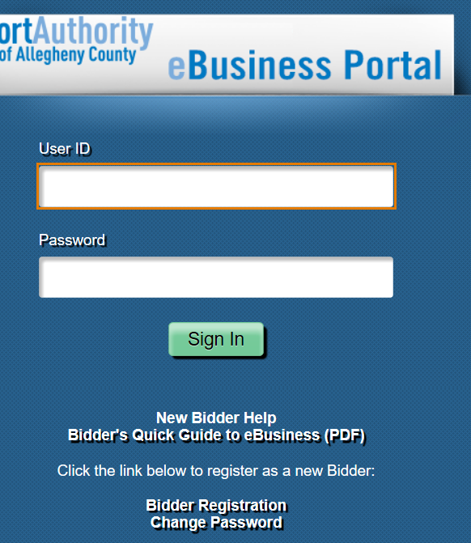
Ebusiness portal overview
Login
Download User Guide
Register
Reset Password

Slide 11
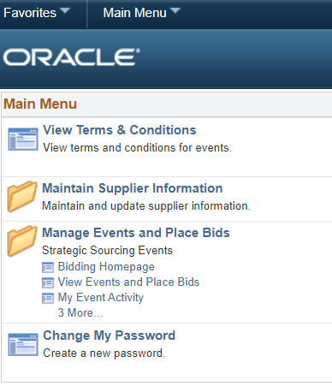
Ebusiness Portal Overview
View Events and Place Bids

Slide 12
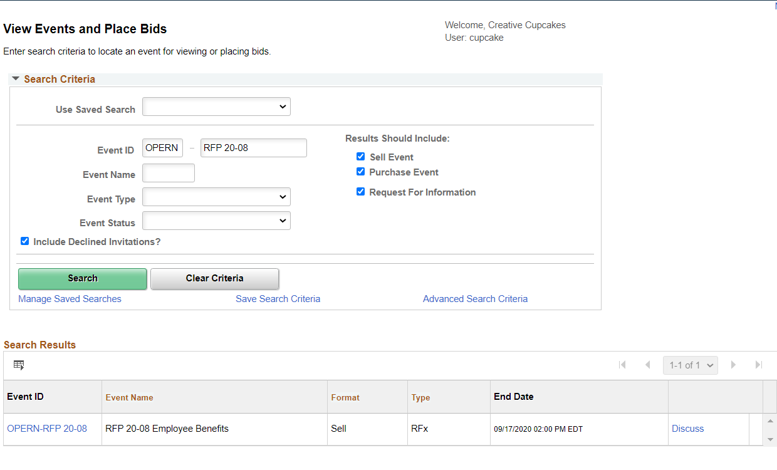
Ebusiness Portal
Overview
This page takes time to load!
Displays all Sourcing Events
Enter Event ID
Search
Click Event ID

Slide 13
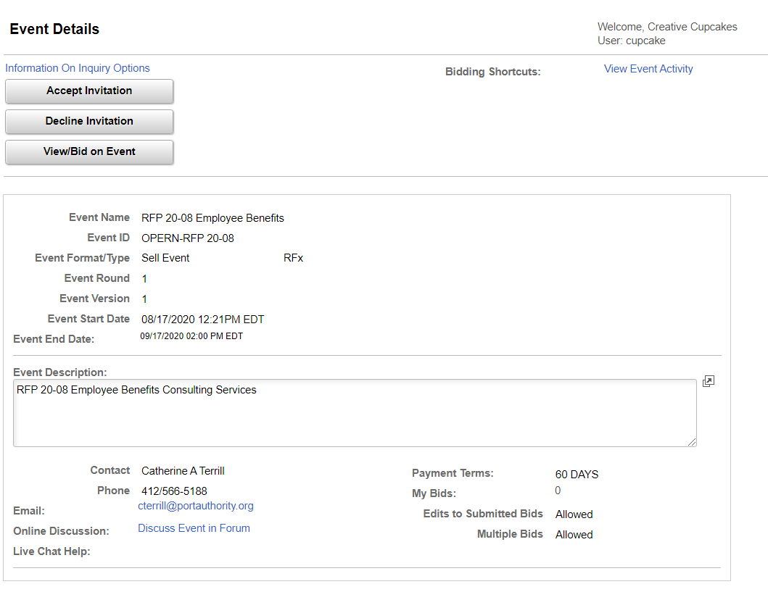
Ebusiness Portal
Overview
Contact Info
Discuss Event in Forum is disabled
Please contact the Contract Specialist directly
Click View/Bid on Event

Slide 14
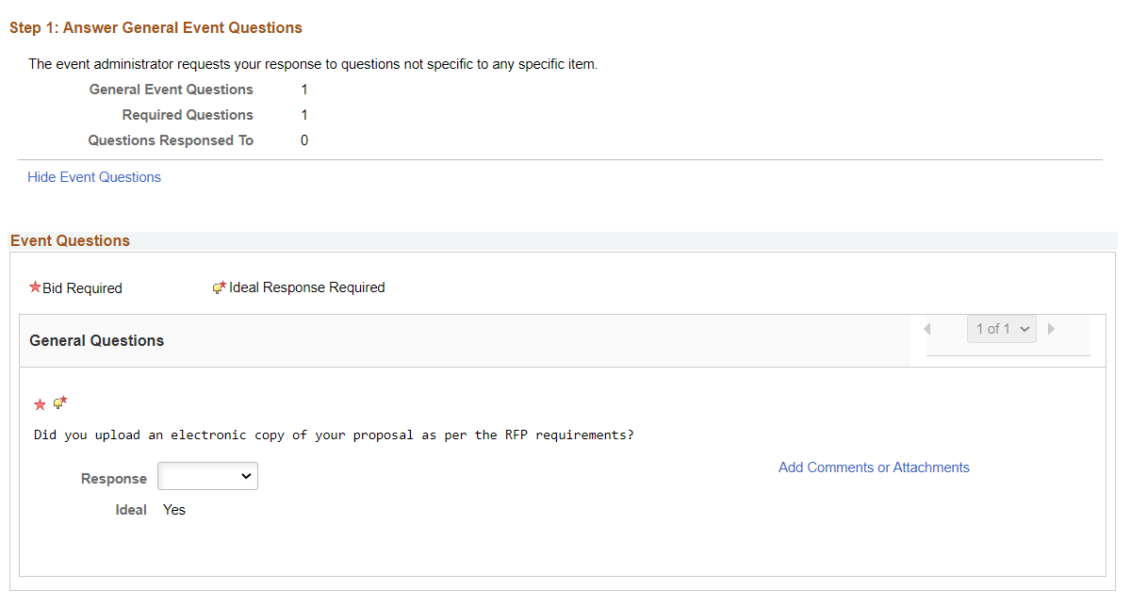
Ebusiness Portal
Overview
Answer General Event Questions
Provides Ideal Answer

Slide 15
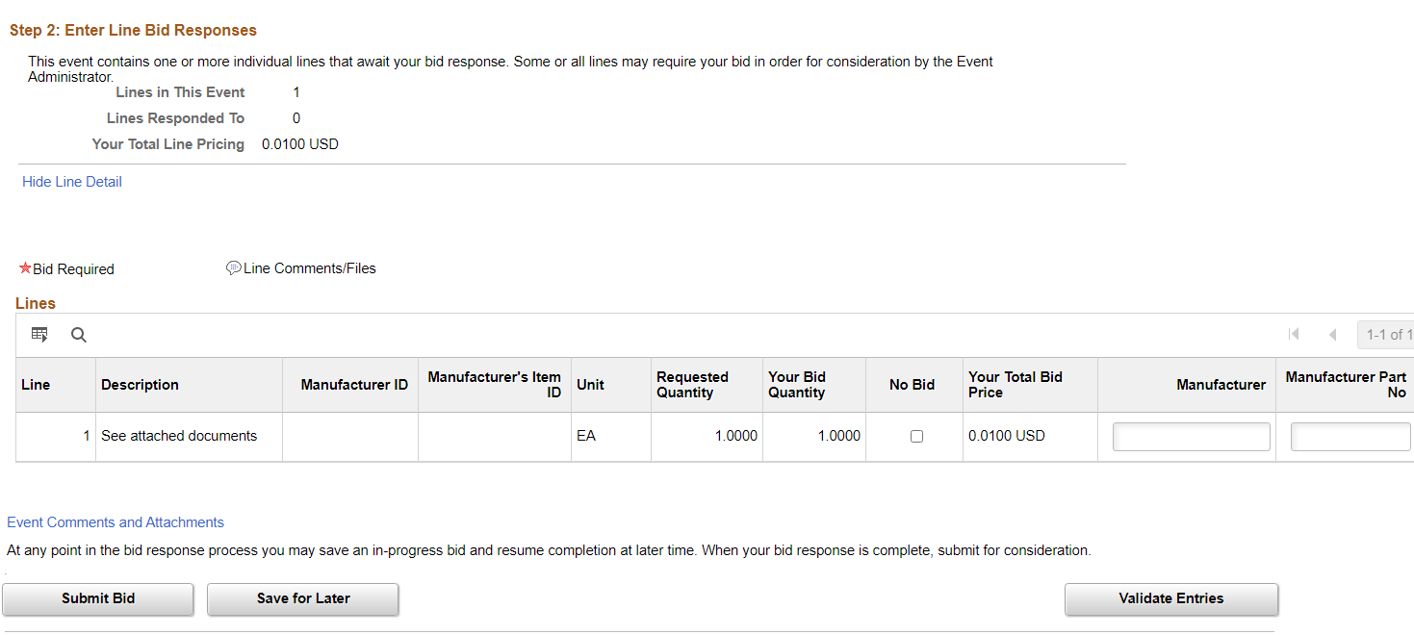
Ebusiness Portal
Overview
Leave Line Item information blank
Event Comments and Attachments

Slide 16
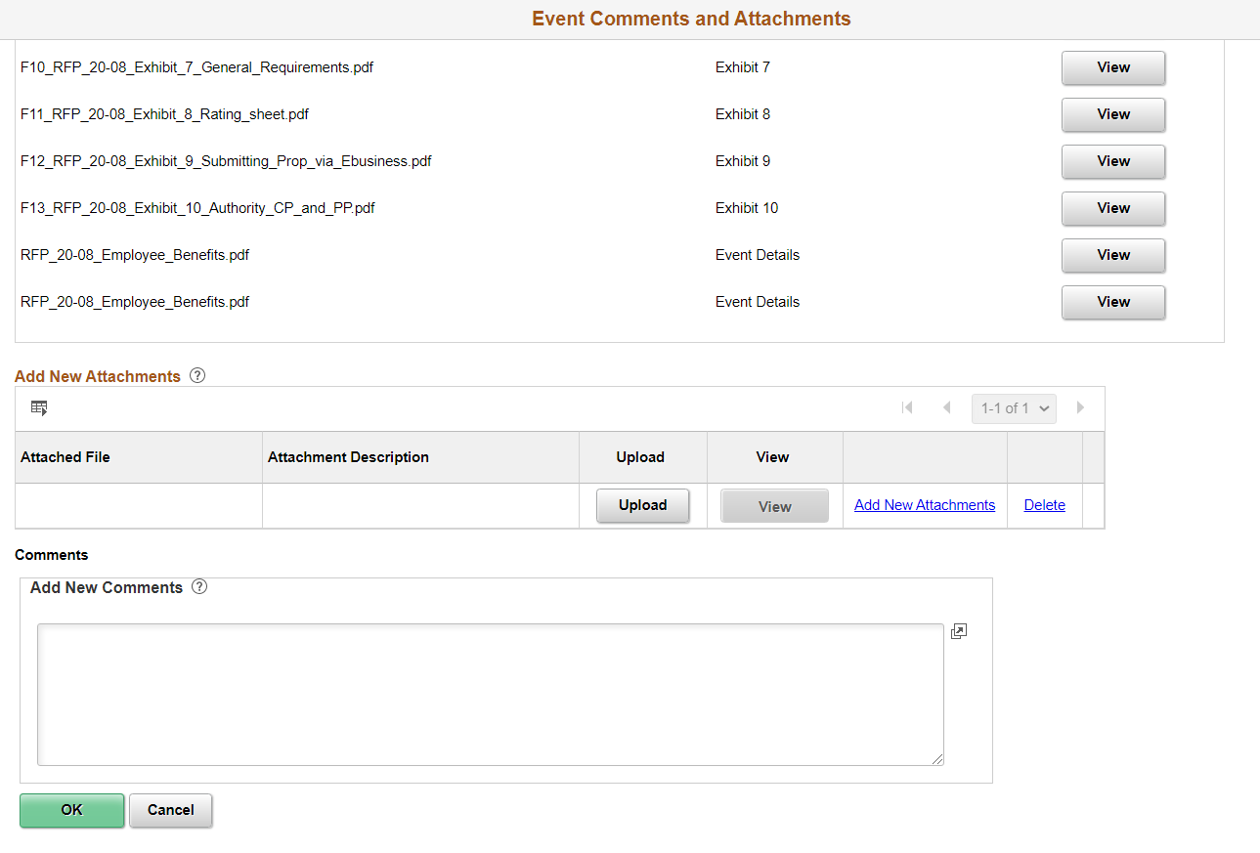
Ebusiness Portal
Overview
Download RFP Documents
Upload Proposal

Slide 17
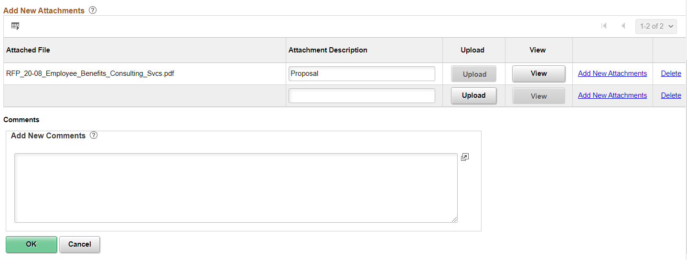
Ebusiness Portal Overview
Enter Attachment Description
Click Add New Attachment for each additional document
Click Ok

Slide 18
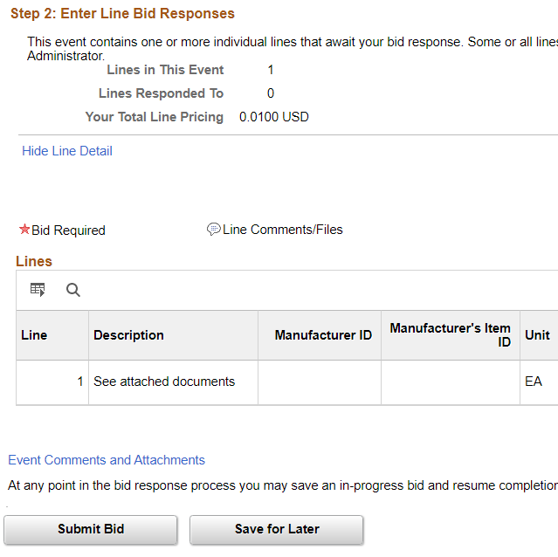
Ebusiness Portal
Overview
Save for Later vs. Submit Bid

Slide 19
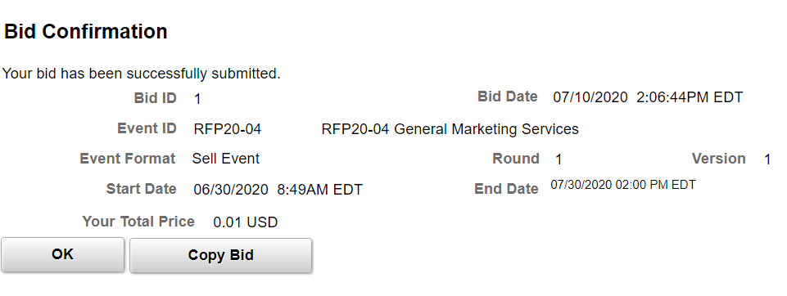
Ebusiness Portal Overview
Click OK
Done!
You will receive an email confirmation that the proposal was submitted

Slide 20

Additional ebusiness information
Carefully select categories related to your type of business
STRONGLY encourage to register multiple personnel
Be proactive in updating eBusiness registration information
Be proactive in checking PRT’s website

Slide 21

eBusiness Support
Please contact the following for eBusiness questions:
Deb Norkevicus at
DNorkevicus@rideprt.org

Slide 22
General Overview of
RFP Requirements

Slide 23
GENERAL INFORMATION
PRT is requesting proposals for:
  Learning Management Systems
Term of the Agreement:
  3-year period with the option to extend up to an additional 2 years.

Slide 24
GENERAL INFORMATION
Proposals must be submitted electronically through PRT’s eBusiness system
  By 2:00 p.m., prevailing time, July 7, 2026
  Instructions have been provided in Exhibit 9 of the RFP
Questions must be received in writing no later than 10 days before Proposals are due.
  Cut off date is June 29, 2026
  Procedural, please contact, Deb Norkevicus
  Clarifications and questions to the RFP
    MUST BE IN WRITING
    Email DNorkevicus@rideprt.org or Fax (412) 566-5359
Tentative Presentation for Board Approval
  September 2026

Slide 25
SECTION 2.1.2
DB/DBE SUBCONTRACTOR PARTICIPATION
Inclusion of DB/DBE participation will be accounted for in the proposal evaluation process.
Certified DBEs can be found on the PAUCP website
  https://paucp.dbesystem.com
  A list of potential DBE firms will be provided in TM#2
If assistance is required in obtaining DB/DBEs:
 | Sue Broadus | Kristy Kwisnek | Robert Beach
PHONE | (412) 566-5257 | (412) 566-5175 | (412) 566-5342
EMAIL | DBEProgram@rideprt.org

Slide 26
SECTION 2.0- PROPOSAL REQUIREMENTS
Structure of Proposal
  Cover
  Letter of Transmittal (Include items identified in Section 2.1.1)
  Section 1 – Overview of Proposal
  Section 2 – Experience Record
  Section 3 – Project Work Plan
  Section 4 – Project Organization and Management Plan
  Section 5 – Summary of Costs
  Appendix Information
Shall be no more than 50 pages
  Appendix information is in addition to page limit
  Font Size for all material shall not be less than 10 pt.

Slide 27
SECTION 2.2
OVERVIEW OF PROPOSER
SECTION 1 OF THE PROPOSAL
Include a description of the Proposer and its subcontractors
Contractor will be required to perform a minimum of 75% of the work
  A maximum of 25% may be subcontracted
  Include percentage of work to be performed by the Proposer and its proposed Subcontractors

Slide 28
SECTION 2.3
EXPERIENCE RECORD
SECTION 2 OF THE PROPOSAL
Provide relevant project experience of Proposer and its Subcontractors
Status (ongoing or completed) and Time Frame
Responsibilities for the Project
Project Manager and Staff for each identified project
Contract Value
Client Contact and contact information. References that cannot be either confirmed or reviewed with your client are not beneficial.

Slide 29
SECTION 2.4
PROJECT WORK PLAN
SECTION 3 OF THE PROPOSAL
Demonstrate understanding and approach
  DO NOT REINTERATE THE RFP SCOPE OF SERVICES
Identify each task and names of individuals or disciplines
  Include Subcontractors
  Include hours associated

Slide 30
SECTION 2.5
PROJECT ORGANIZATION AND MGMT. PLAN
SECTION 4 OF THE PROPOSAL
Description, roles, and responsibilities for Contract Services
  Project Manager
  Key Personnel
  Subcontractors
Provide Organizational Chart
  Include individual’s name
  Include company
  Include proposed role

Slide 31
SECTION 2.6
SUMMARY OF COSTS
SECTION 5 OF THE PROPOSAL
Sample forms provided in Exhibit 6
  Alternate fee structure may be proposed.
A separate Summary of Costs form is required for each subcontractor.

Slide 32
SECTION 2.7
APPENDIX INFORMATION
APPENDIX SECTION OF THE PROPOSAL
Financial Information
  Two (2) most recent financial years
  Publicly held firms shall include in the Proposal
  Privately held firm may defer until notice of being short-listed
Certifications
  Exhibit 2 [Certification of Debarment]
  Exhibit 3 [Certification of Lobbying and Disclosure Form]
  Prime Contractor submission only. Subcontractors prior to award of Agreement.
Resumes
  Exhibit 5
  Not to exceed 20 pages

Slide 33
SECTION 2.7
APPENDIX INFORMATION
APPENDIX SECTION OF THE PROPOSAL
Key Personnel Letter(s)
  Signed letter by Proposer and any of its proposed subcontractors
Affirmative Action and Equal Opportunity Policy Statement
  Signed and dated
  DO NOT SUBMIT ACTUAL POLICY
Insurance Coverage Statement
  Requirements in Exhibit 1, Sample Agreement
  DO NOT SUBMIT CERTIFICATE OF INSURANCE AT THIS TIME

Slide 34
SECTION 3.0
PROPOSAL SELECTION PROCESS
EXHIBIT 8 – EVALUATION RATING CRITERIA
RFP REF SECTION | RATING CRITERIA | WEIGHTED MULTIPLIER
2.1.2 | DB/DBE Utilization | 4
2.3 | Experience Record | 6
2.5 | Project Work Plan | 4
2.5.2 & 3 | Project Organization & Mgmt Plan | 5
2.5.2 | Project Mangemer / Staff Resumes | 6
2.6 | Summary of Costs | 8
 | TOTAL WEIGHTED SCORE: | 33

Slide 35
TENTATIVE DATES
(DATES ARE SUBJECT TO CHANGE AT THE DISCRETION OF PRT)
Last day for questions June 29, 2026
Proposal due at or before 2:00pm July 7, 2026
Interviews July 29 & 30, 2026
Presentation for Board Consideration September 2026
Commencement of Services October 2026

Slide 36

SECTION 4
SCOPE OF SERVICES
Overview of the Scope of Services
Presented by
Danielle Jacobson / Steve Sarosi

Slide 37

QUESTIONS AND
ANSWER SESSION
All questions must be submitted in writing via email to
DNorkevicus@rideprt.org

